Slide 1

倾听客户心声
利用语音科技提供个性化服务与强化用户体验/ 吴宗承

Slide 2
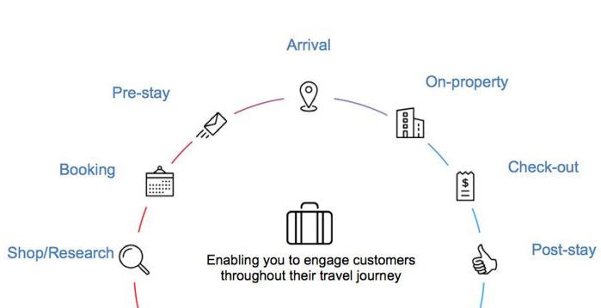
Hotel 绩效评估的环节
Check-in
住宿
入住前
预订
退房
浏览网站
宿后体验
客户的出差旅游行程

Slide 3

客户体验
天气
打车
行事历
餐厅
预订
生活资讯
空调温度
运动赛事
IA
环境
湿度
音乐
灯光亮度

Slide 4

智能助理 (IA)

Slide 5
Alexa Voice Service (AVS)

Slide 6

Alexa 应用 (ASK)

Slide 7

什么是Alexa 应用
Alexa
亚马逊提供的语音服务
让使用者可以用更直觉的方式跟硬件沟通
Alexa 应用
自我服务的API，工具，文档和代码示例
能轻松且快速的制作自已需要的应用
所有代码都是运行在云端

Slide 8




Alexa 应用的优势
自然且基于语音的新世代介面，Alexa 有机会让您抢得先机
已有大量的硬件与Alexa 整合，能任您接触到更广的客户群
用全新的互动方式与您的客户交互，客户无需双手，只要说出指令
低学习成本，您只需要几个小时的时间，就能快速上手开发
利用AWS Lambda 可以轻松建构一个基于云端且能快速响应的语音服务
完全免费的！AWS Lambda 每个月的前一百万次请求也是免费的！！

Slide 9
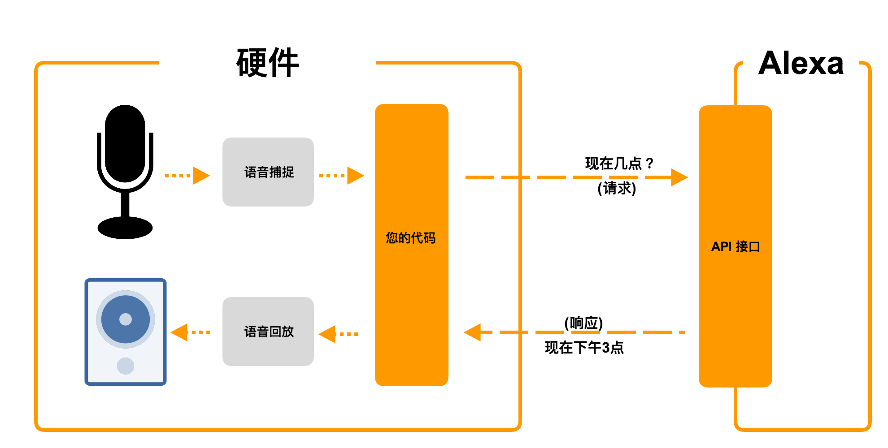
Alexa 语音服务

Slide 10
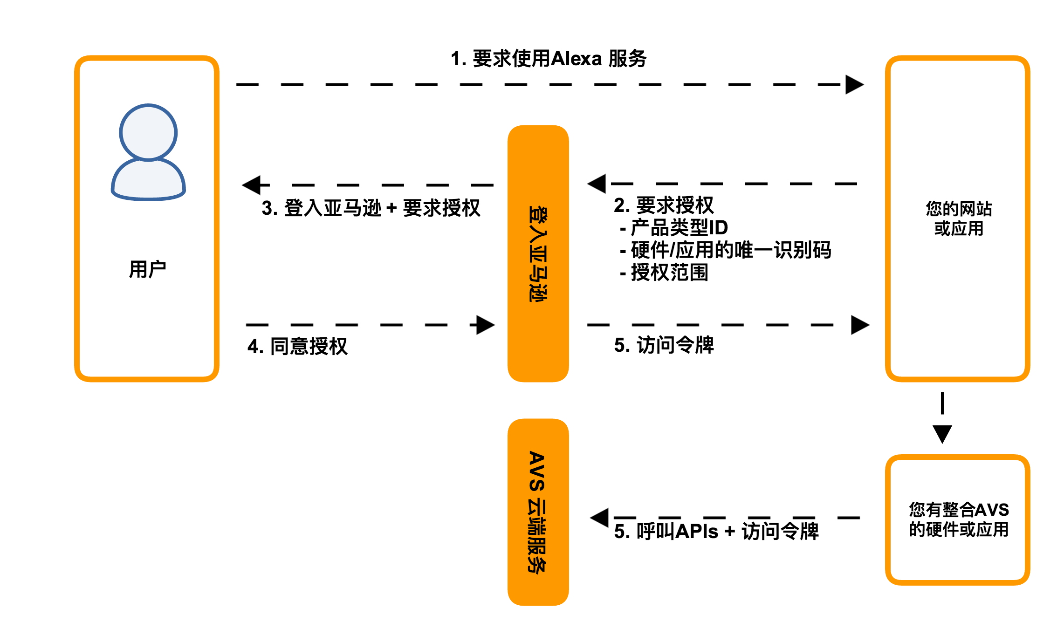
AVS 整合流程

Slide 11


客户与Alexa 应用的互动
只要讲出”Alexa” 就能唤醒硬件

Slide 12

客户与Alexa 应用的互动
"Alexa, ask Sun Tzu for today’s lesson"
只要讲出”Alexa” 就能唤醒硬件

Slide 13

客户与Alexa 应用的互动
"Alexa, ask Sun Tzu for today’s lesson"
“Ask…for” 是一个默认支持的服务词组

Slide 14

客户与Alexa 应用的互动
"Alexa, ask Sun Tzu for today’s lesson"
”Sun Tzu” 是客户定义调用应用的词组

Slide 15

客户与Alexa 应用的互动
"Alexa, ask Sun Tzu for today’s lesson"
”today’s lesson” 是对应用的命令

Slide 16
Demo: 如何制作一个Alexa 应用

Slide 17
Voice User Interface设计的最佳实践

Slide 18

1. 让使用者清楚的知道该回应什么
不好的例子
Trivia challenge: Trivia Challenge. You can choose from the following categories: 80’s Pop Songs, Potent Potables, or European History.
Notes:
Presenting the options alone does not sufficiently inform the user that they need to respond, so make sure you ask the user a question so they know that they are expected to say something.

Slide 19
1. 让使用者清楚的知道该回应什么
较好的例子
Trivia challenge: Trivia Challenge. Here are your categories: 80’s Pop Songs, Potent Potables, or European History. Which one do you want?

Slide 20

2. 别预期用户知道下一步会发生什么
不好的例子
Car Fu: Car Fu.
Notes:
Presenting the options alone does not sufficiently inform the user that they need to respond, so make sure you ask the user a question so they know that they are expected to say something.

Slide 21
2. 别预期用户知道下一步会发生什么
较好的例子
Car Fu: Car Fu. You can ask to get a ride or request a fare estimate. Which will it be?
User: Get a ride.
Car Fu: Sending your request. A mobile alert on your cell phone will let you know when your car arrives.

Slide 22

3. 给予使用者明确清晰的选项
不好的例子
Food Taxi: Would you like french fries or a salad?
User: Yes
Notes:
Presenting the options alone does not sufficiently inform the user that they need to respond, so make sure you ask the user a question so they know that they are expected to say something.

Slide 23
3. 给予使用者明确清晰的选项
较好的例子
Food Taxi: Which side would you like: French fries or a salad?
User: Salad.

Slide 24

4. 尽量简洁扼要
不好的例子
Astrology Daily: There are 12 Zodiac signs that I can give you a horoscope for. Please tell which one you’d like.
Notes:
Presenting the options alone does not sufficiently inform the user that they need to respond, so make sure you ask the user a question so they know that they are expected to say something.

Slide 25
4. 尽量简洁扼要
较好的例子
Astrology Daily: Get the Horoscope for which sign?
Notes:
Presenting the options alone does not sufficiently inform the user that they need to respond, so make sure you ask the user a question so they know that they are expected to say something.

Slide 26
5. 避免冗长的选项
不好的例子
Image Here
Dairy Shack: What flavor do you want? For chocolate, say Chocolate. For vanilla, say Vanilla. Or for strawberry, say Strawberry.
Notes:
When presenting users with a list of options to choose from, make sure choices are clearly stated, do not present more than three choices, and avoid repetitive wording.

Slide 27
5. 避免冗长的选项
较好的例子
Dairy Shack: Which flavor would you like? You can say Chocolate, Vanilla, or Strawberry.
Notes:
When presenting users with a list of options to choose from, make sure choices are clearly stated, do not present more than three choices, and avoid repetitive wording.

Slide 28
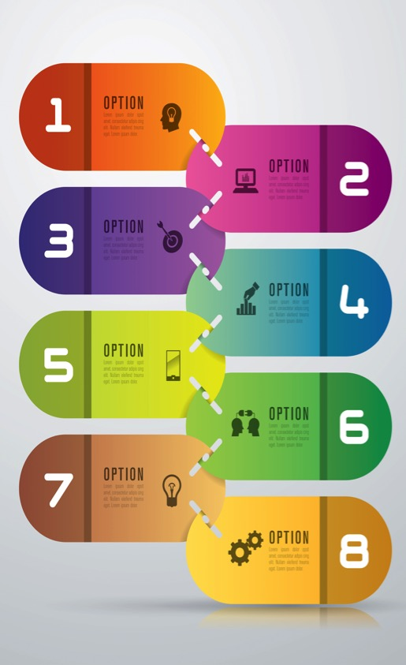
6. 避免复杂的交互
不好的例子
Image Here
Score Keeper: Score Keeper. You can give a player points, add a new player, ask for the score, start a new game, clear all players, or stop if you’re done. Now, what would you like?
User: What was that again?
Notes:
When your Alexa capability does a lot of things (more than three), you should not try to fit every option into a single prompt. Instead, present the most important options first, along with help. If the user asks for help, you should list out all your capabilities. Remember to ask the user a question after presenting the options.

Slide 29
6. 避免复杂的交互
较好的例子
Image Here
Score Keeper: Score Keeper. You can give a player points, ask for the score, or say Help. What would you like?
User: Help.
Score Keeper: Here are some things you can say:
add John, give John 5 points, tell me the score, start a new game, or reset all players.
You can also say stop if you’re done.
So, how can I help?
Notes:
When your Alexa capability does a lot of things (more than three), you should not try to fit every option into a single prompt. Instead, present the most important options first, along with help. If the user asks for help, you should list out all your capabilities. Remember to ask the user a question after presenting the options.

Slide 30

7. 一次性的资讯与使用
不好的例子
“One, Two, Five!”
“Three, sir! Three!”
Joke Bank: Would you like to hear a joke?
User: Yes.
Joke Bank: What’s black, white, and red all over? An embarrassed skunk.
Notes:
You should make smart assumptions when possible in order to avoid unnecessary questions. Asking non-essential questions adds friction to the user experience and makes your experience seem less thoughtful. Examples:
If your skill only does one thing, do not ask the user if they want to do that thing.
Make educated guesses when appropriate (without making it difficult to correct).
Tailor prompt examples based on the user (e.g., user profile).

Slide 31
7. 一次性的资讯与使用
较好的例子
Joke Bank: What’s black, white, and red all over? An embarrassed skunk.
Notes:
You should make smart assumptions when possible in order to avoid unnecessary questions. Asking non-essential questions adds friction to the user experience and makes your experience seem less thoughtful. Examples:
If your skill only does one thing, do not ask the user if they want to do that thing.
Make educated guesses when appropriate (without making it difficult to correct).
Tailor prompt examples based on the user (e.g., user profile).

Slide 32
AVS 轻松入门
阅读 Getting Started Guide, 这份文档会详细描述如何从在您的硬件上呼叫AVS APIs
阅读 API Reference 来学习如何使用AVS 的RESTful APIs
阅读Reference Implementation Guide 来学习如何设定我们提供的参考硬件
申请免费的开发者帐号, 注册您的硬件与应用, 就能马上开始使用 AVS

Slide 33
AWS IoT

Slide 34









AWS物联网是一个完全托管的云平台，可以轻易的管理连接的设备，安全的与其进行交互
可透过不同的网络与通讯协议，安全的连接与管理设备
抽取与过滤设备传回的数据，并采取您定义的规则操作
轻易的创建能全时可靠与设备交互的应用
设备 SDK
设备安全与权限管理
设备网关
注册
规则引擎
设备之影(Shadow)

Slide 35
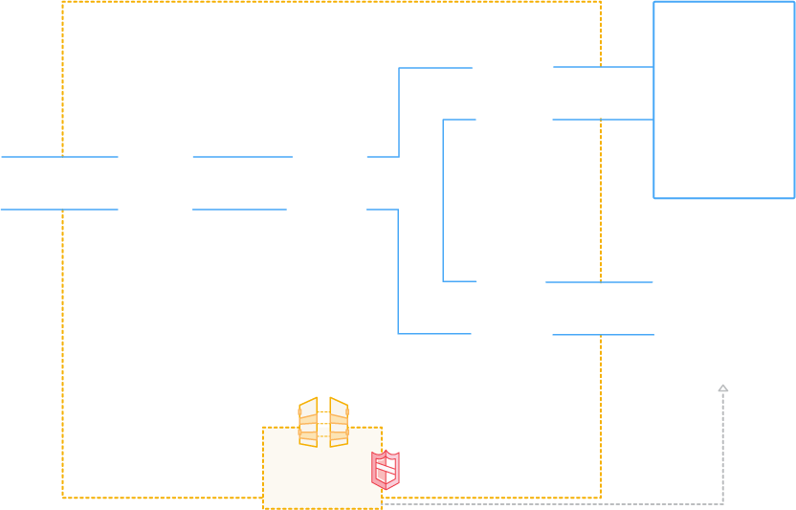








AWS物联网 - 整体流程
认证
相互身份验证和加密
AWS 服务
- - - - -
第三方服务
规则引擎
依据规则与路由传递资料给后端AWS 服务
设备SDK
多种客户端连结库，进行身份验证和交换信息
设备网关
通过MQTT和HTTP与设备通信
应用
设备之影(Shadow)
为设备间断性的连接能力保有持久的状态
注册
身份验证和管理你的设备
AWS物联网API
Notes:
Transition back to Marco

Slide 36








AWS物联网的发布/订阅代理
设备
MQTT/TLS
MQTT/TLS
MQTT/TLS
MQTT/TLS
安全
发布/订阅
代理
HTTP/TLS
应用
HTTPS/SIGV4

Slide 37











AWS物联网规则引擎
1. AWS服务 （已直接整合）
2. AWS其他服务 （通过Amazon Kinesis,
Lambda, S3等服务）
S3
DDB
Amazon Kinesis
RDS
Amazon Glacier
规则行动
规则引擎
SNS
Lambda
SQS
Amazon Redshift
EC2
规则引擎连接AWS物联网外部端点与内部AWS服务
3. 外部端点 （透过SNS, Lambda）

Slide 38



AWS物联网设备软件开发工具包
C-SDK
(理想使用场景 embedded OS)
JS-SDK
(理想使用场景 Embedded Linux Platforms)
Arduino Library
(Arduino Yun)
Mobile SDK
(Android and iOS)

Slide 39
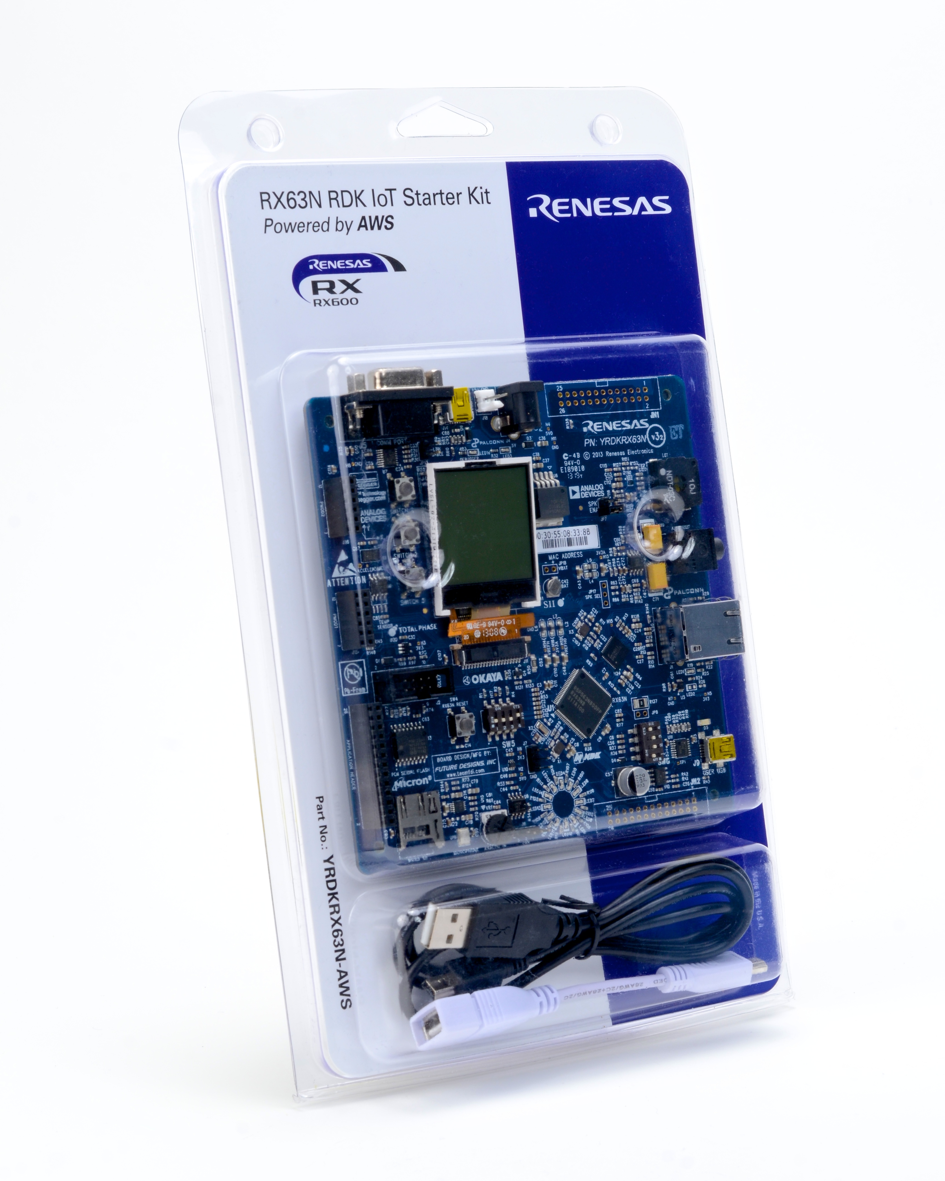

















AWS物联网Starter Kits

Slide 40



‘$aws/things/abot-lamp/shadow/update’
{
“state” : {
"reported": {
"on": false
}
}
}
on: false

Slide 41
‘$aws/things/abot-lamp/shadow/update’
{
"state" : {
"desired": {
"on": true
},
"reported": {
"on": false
}
}
}
on: true

Slide 42
‘$aws/things/abot-lamp/shadow/update’
{
"state" : {
"desired": {
"on": true
},
"reported" : { un-sync
"on": false
},
{
"delta": {
"on": true
}
}
}

Slide 43
‘$aws/things/abot-lamp/shadow/update’
{
"state" : {
"desired": {
"on": true
},
"reported": {
"on": false
},
{
"delta" : {
"on": true
}
}
}
on: true

Slide 44
‘$aws/things/abot-lamp/shadow/update’
{
"state" : {
"desired": {
"on": true
},
"reported": {
"on": true
}
}
}
on: true

Slide 45
‘$aws/things/abot-lamp/shadow/update’
{
"state" : {
"desired": {
"on": true
},
"reported": {
"on": true
}
}
}
on: true

Slide 46


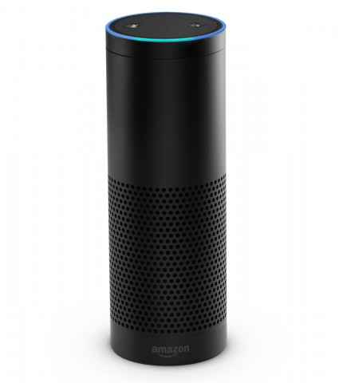

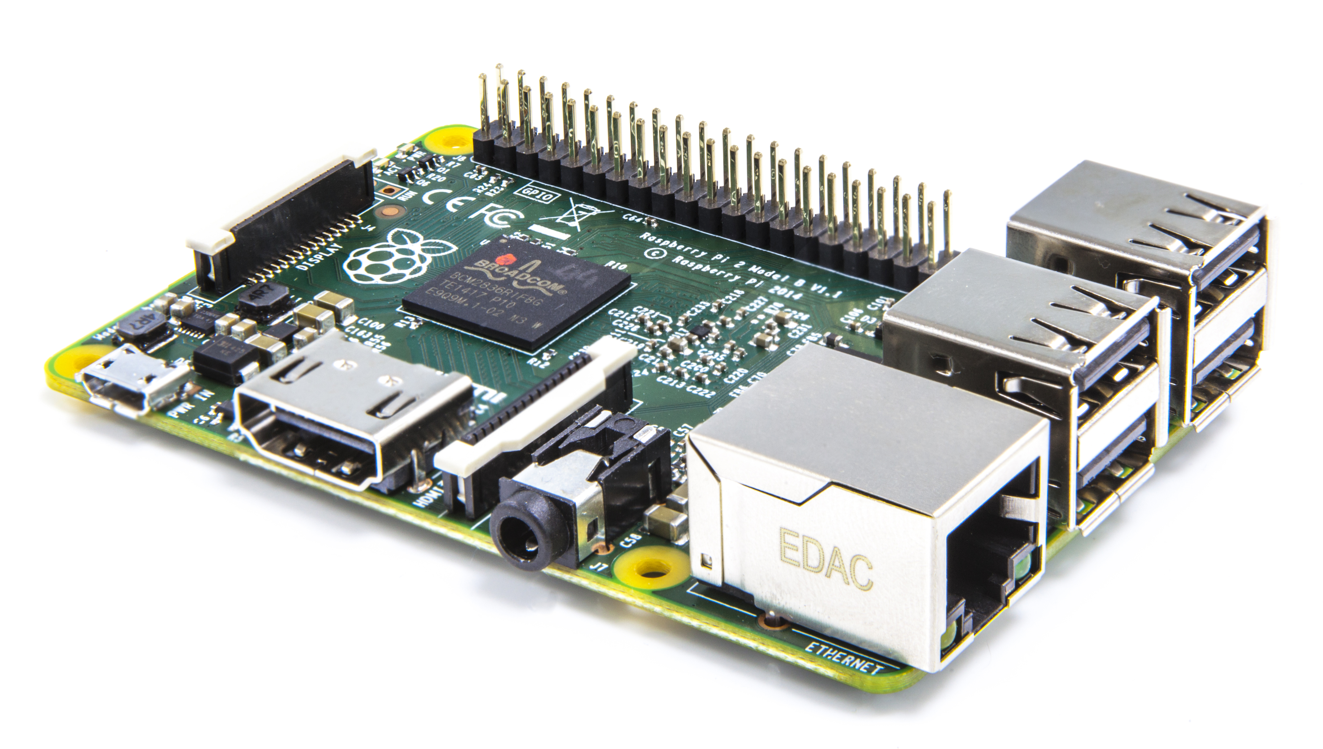
Alexa 语音服务+ AWS IoT = 硬件有語音互動的能力
AVS
整合硬件
Fire TV
Echo

Slide 47










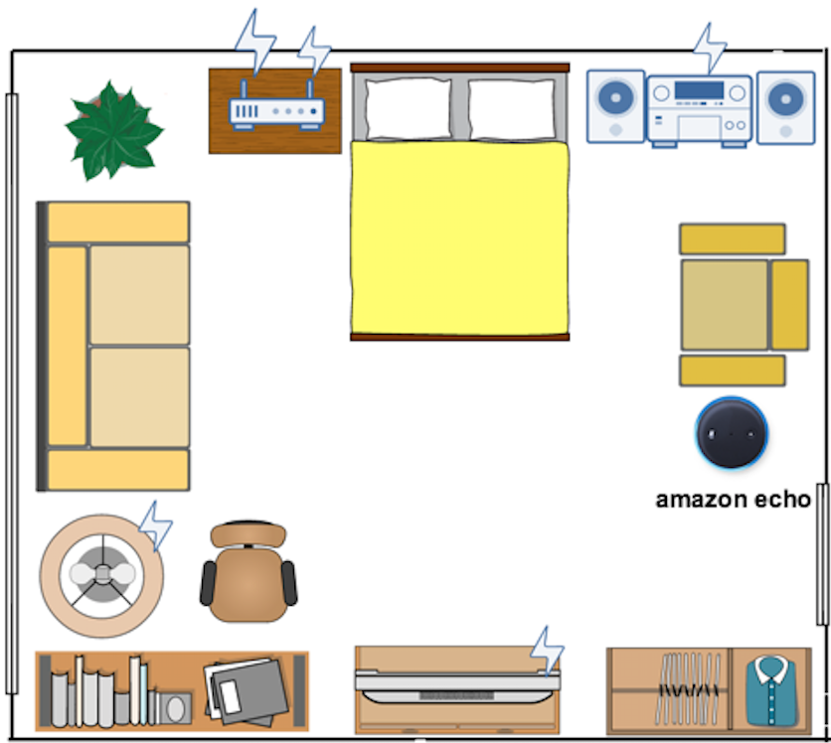






参考架构图
设备影子
规则引擎
安全证书
AWS IoT
Amazon S3
Amazon EMR
Amazon Redshift
Amazon QuickSight
Amazon ElasticSearch Service
ASK
AWS Lambda
AVS
Amazon Kinesis
amazon echo
Amazon SNS

Slide 48
总结
使用AWS物联网来管理与连接您的设备
高扩展性的pub/sub 代理
轻松连接数以万计的设备
强大的规则引擎
使用Alexa 應用部屬新一代的使用交互
简易地实现语音功能
多样的互动性
免費
充分利用AWS零部属的优点
低成本
弹性使用
無固定設施的負擔

Slide 49


